Slide 1

Database Design for a Hospital Management Application
Muhammad Osama
U41261655

Slide 2
Introduction
Hospital Management System Mobile Application.
“Health Matters”
Targeted for use by hospitals to improve their work efficiency.
To reduce complexity, we will only be focusing on the doctor and patient entities for the application.
Provide ease of access for payments, appointments, etc. to the patients and the doctors.

Slide 3
Initial Business Rules
Each patient may have many appointments; each appointment has only one patient.
Each doctor may have many appointments; each appointment has only one doctor.
Each patient must have a billing; each billing must have a patient.
An appointment will have only one diagnosis; a diagnosis will have only one appointment.

Slide 4
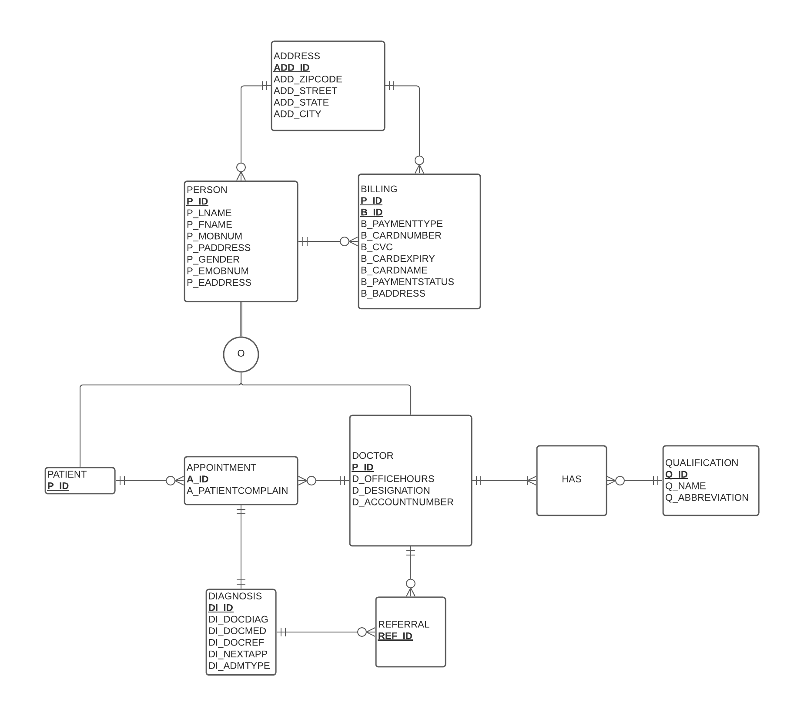
Enhanced ERD

Slide 5
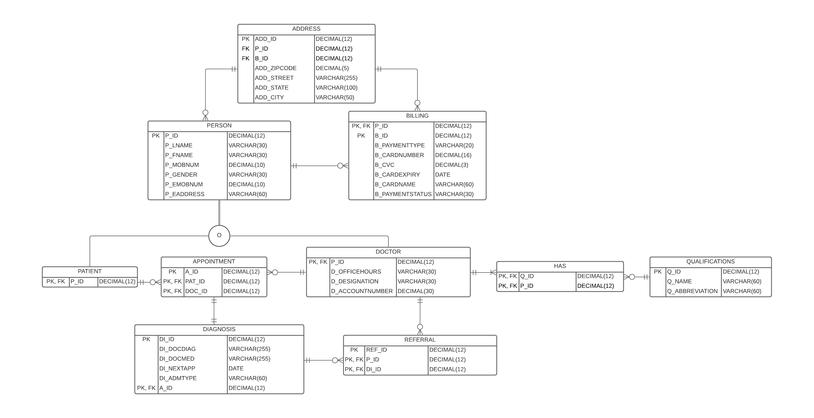
Physical ERD Before Normalization

Slide 6
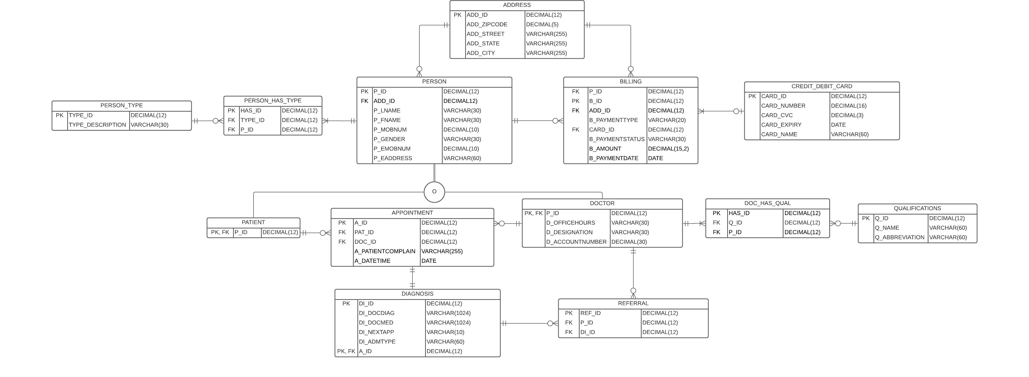
Physical ERD after Normalization

Slide 7
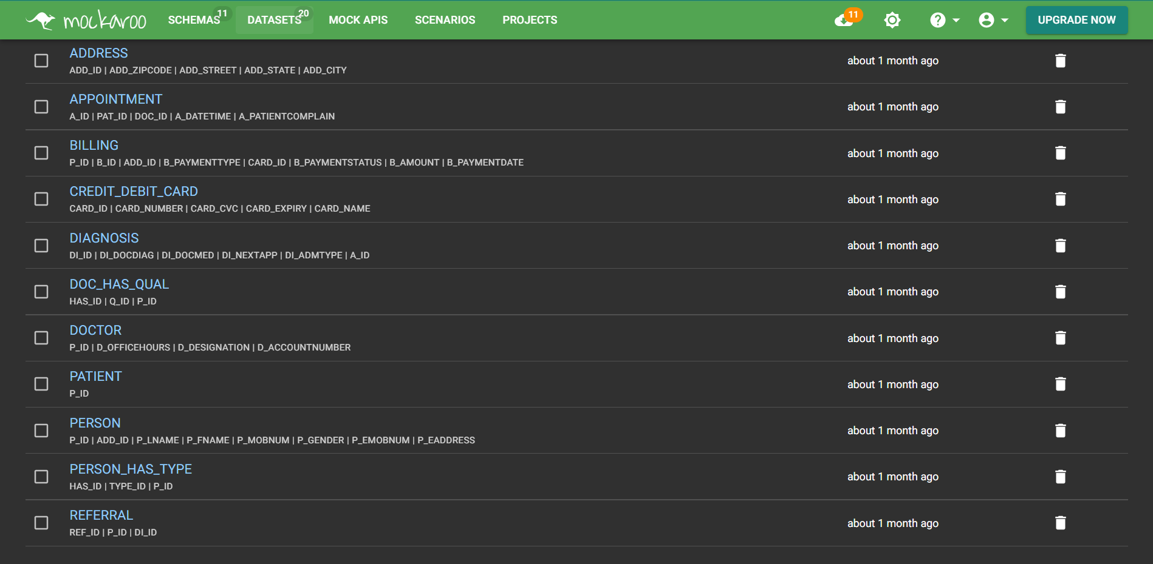
Using Mockaroo to create Schemas

Slide 8
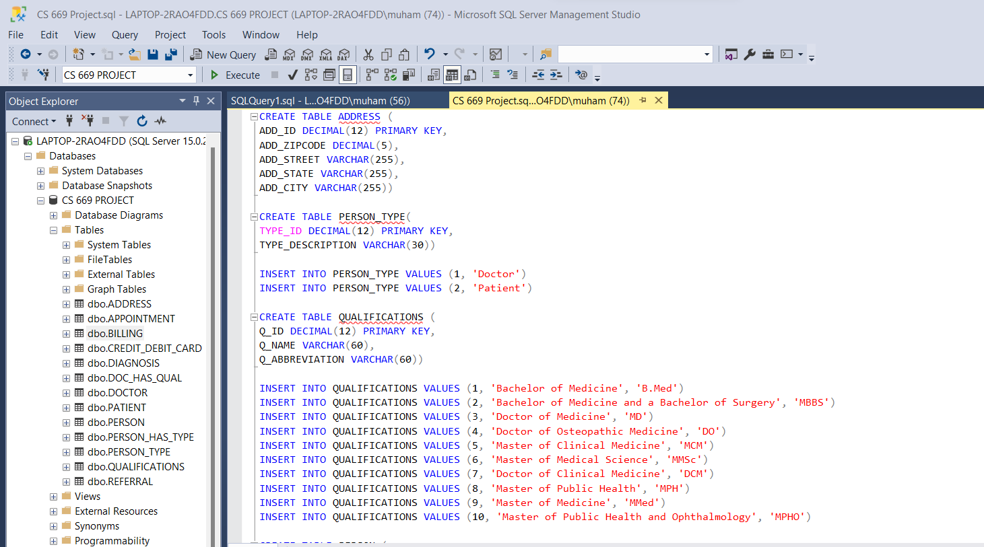
Creating Tables & Inserting Data

Slide 9
Indexing
Primary keys of tables are already indexed.
Indexing foreign keys because they are mostly used in table joins.
Indexing some additional columns in the database that might be frequently used by the hospital administration such as billing payment status and patient admission type.

Slide 10
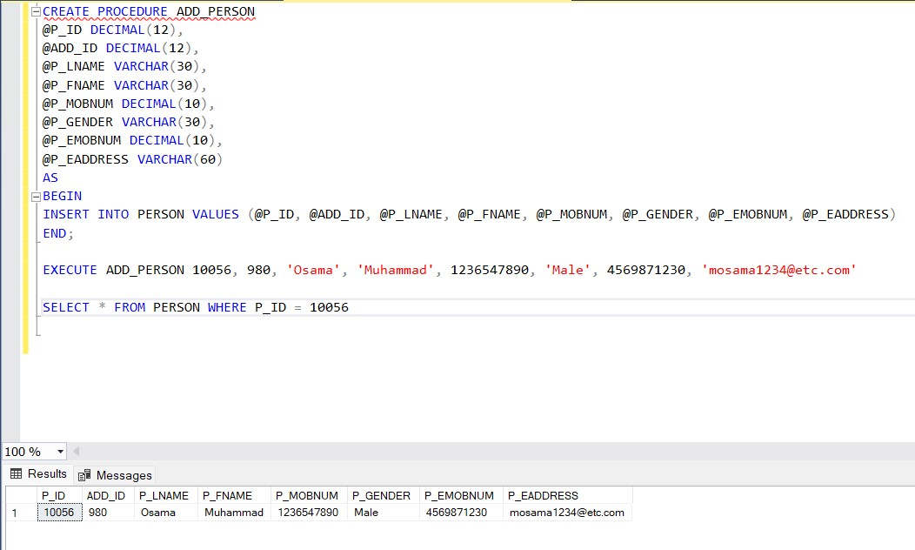
Procedure – Add Person

Slide 11
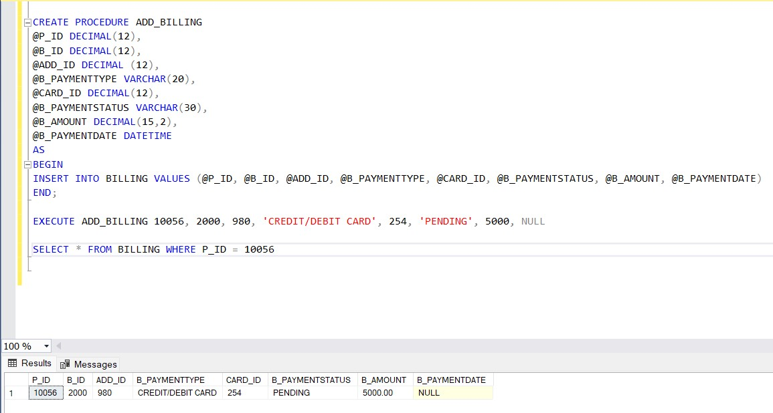
Procedure – Add Billing

Slide 12
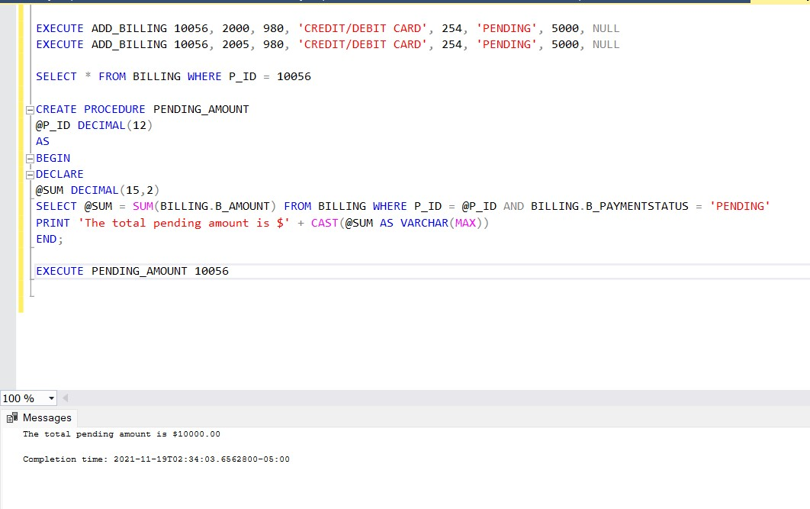
Procedure – Pending Amount

Slide 13
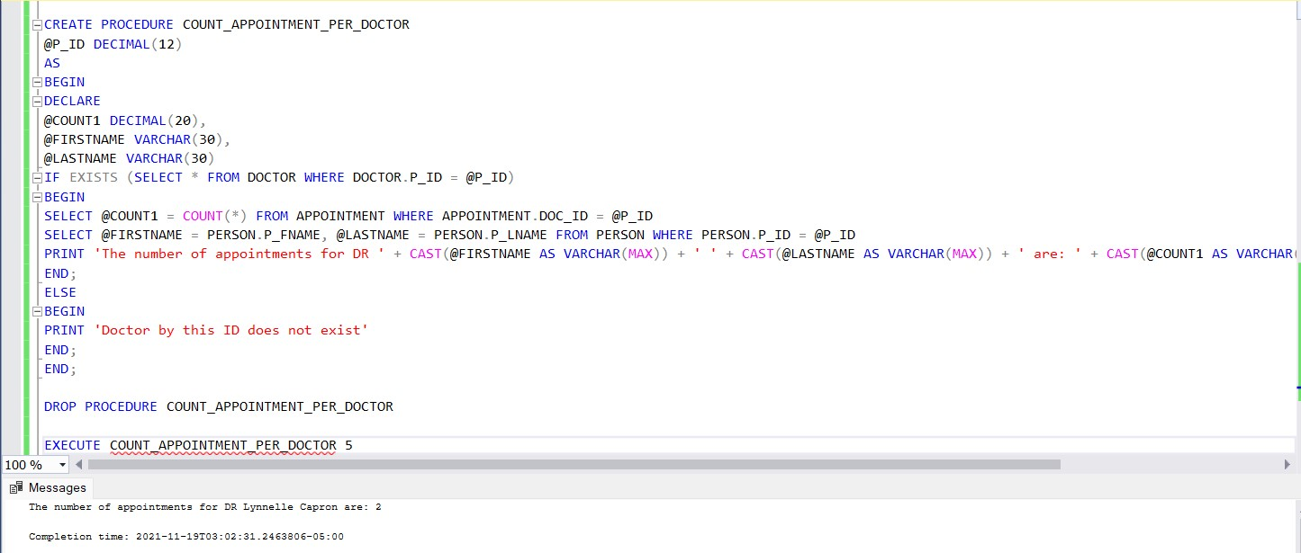
Procedure – Appointments per Doctor

Slide 14
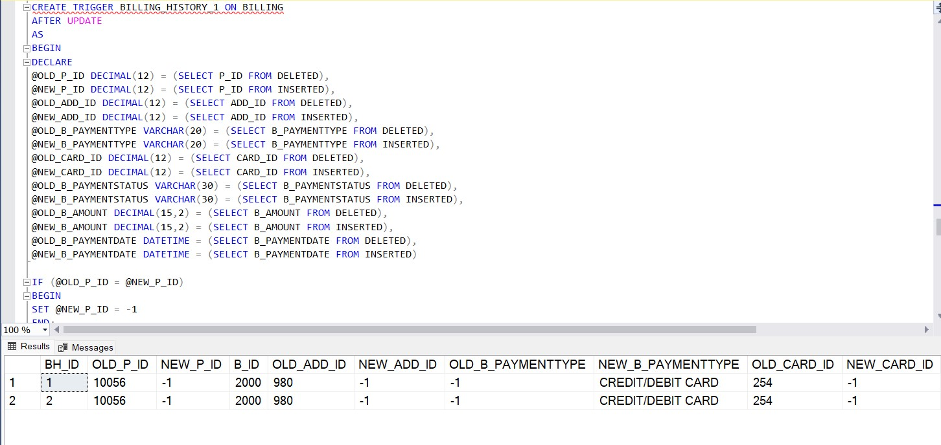
Trigger – Billing History

Slide 15
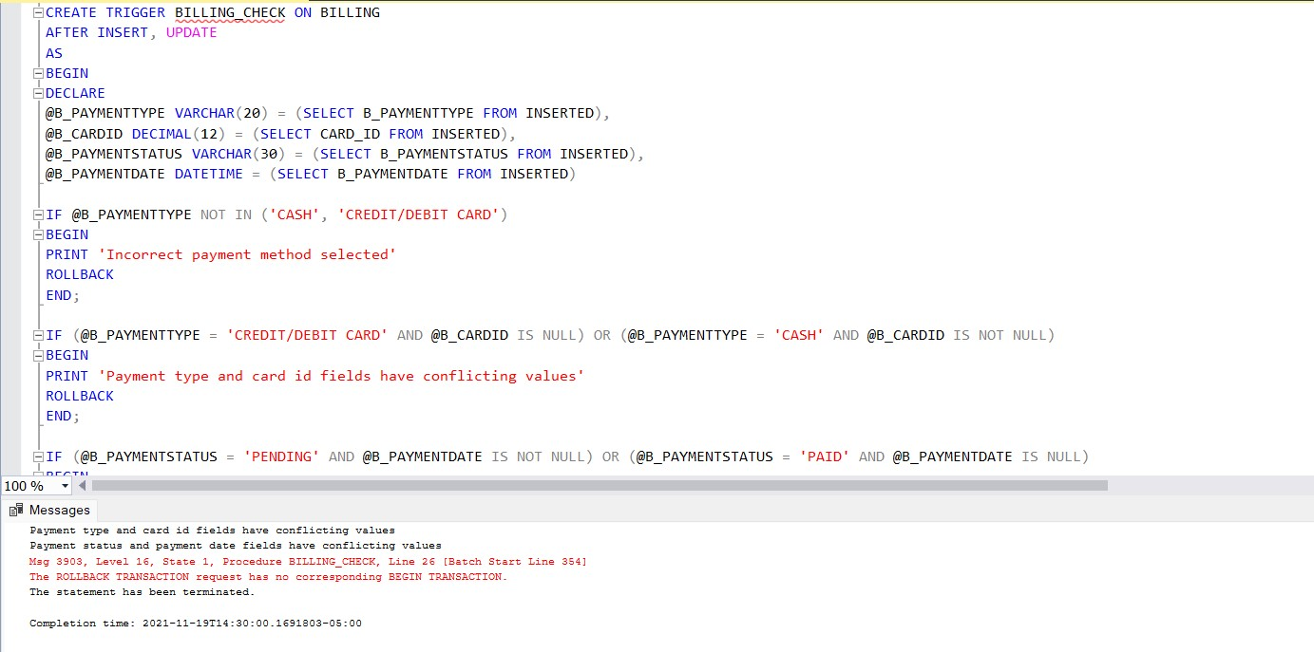
Trigger – Billing Check

Slide 16
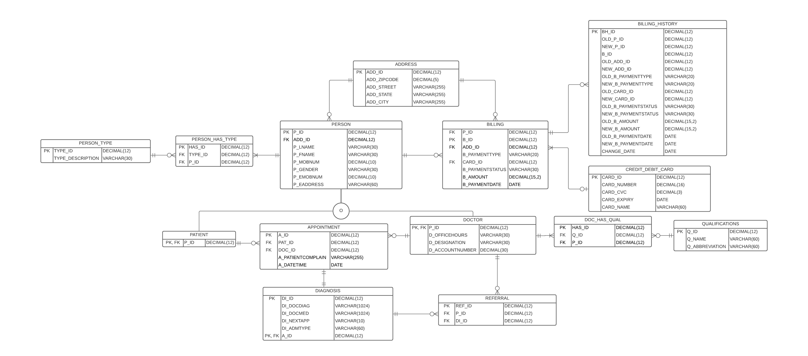
Physical ERD – Updated after adding History Table

Slide 17
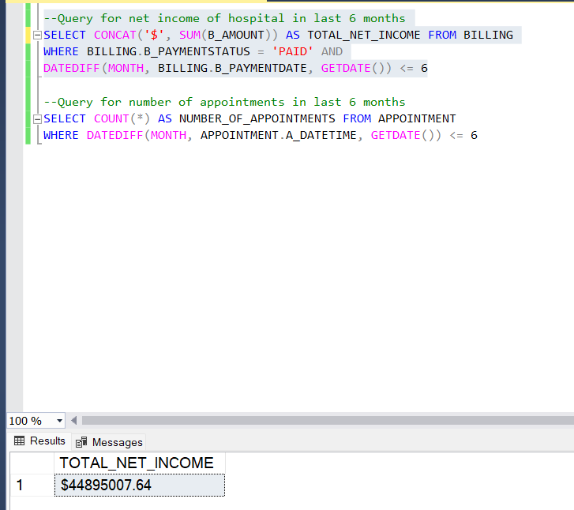
Query for net income of hospital in last 6 months

Slide 18
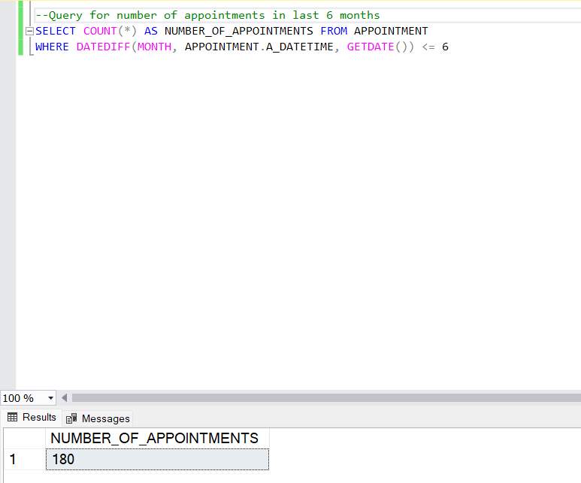
Query for number of appointments in last 6 months:

Slide 19
Conclusion
First time learning SQL. A great learning experience.
Procedures & Triggers fascinated me.
If I had more time, I would look into extending this database to include more person sub entities and creating more checks on the dataset using triggers.

